Slide 1
Rollerball Iteration II
Team The Best Team

Slide 2
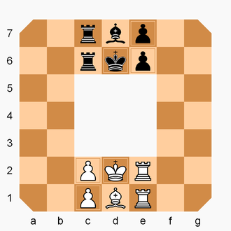

Rollerball

Slide 3
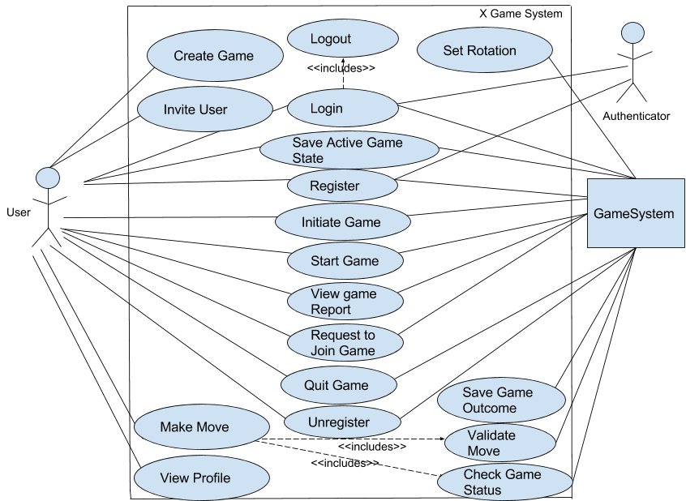
Old Use Case Diagram

Slide 4
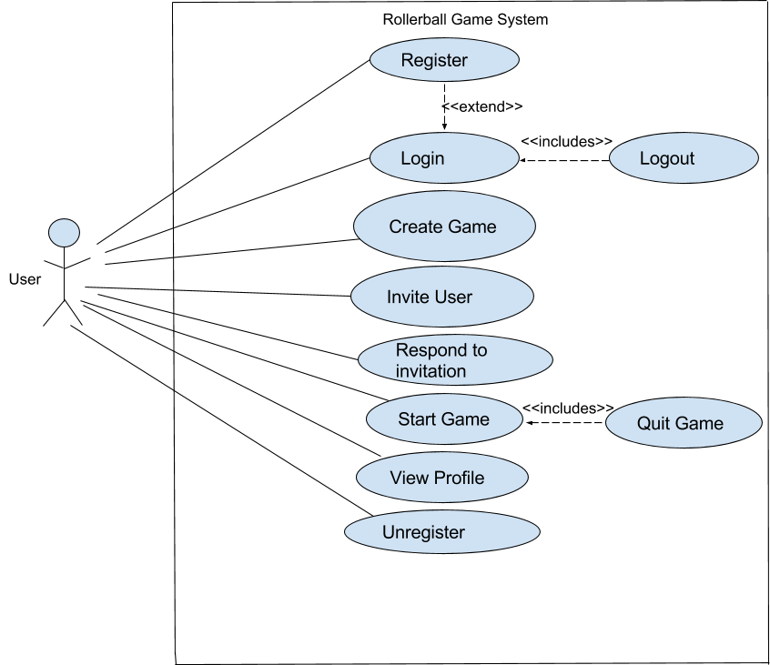
Updated Use Case

Slide 5
Use Case Changes
Removed
Use Cases: Start Game, Request To Join, Initiate Game, Set Rotation, Check game status, make move, Validate Move, Save Active Game State
Model: Authenticator - Unnecessary , Game System - Unnecessary
Updated
Use case alternative flow aligned with the main flow

Slide 6
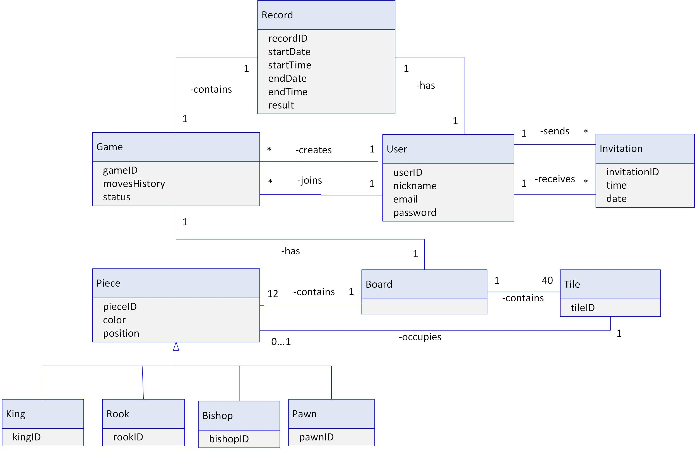
UML Class Diagram

Slide 7
Project Decisions
Configuration Class
Connect And Test Database
Test database
Stores Username, Email, and Password
MySQL DB

Slide 8

Questions

